Slide 1
Acquisition Analytics Insights
By
Chaithanya Kumar Gadi

Slide 2
Problem Statement
Predict the probability of a response from each prospect and target the ones most likely to respond to the next telemarketing campaign.
Business Objective
Achieve 80% of total responders at the minimum possible cost. Calculate the X in the top X%, i.e., how many prospects should be called to meet the business objective?
Assumption Made
While analyzing marketing cost and response, assumed that the cost of a phone call is independent of its duration (₹1 per call), which is not true practically. So, built model without “duration” variable.

Slide 3
Methodology
Identified following variables as relevant in predicting response from customers:
job_retired
month_mar
poutcome_success
job_student
month_may
cons.price.idx
contact_telephone
previous_Nevercontacted
euribor3m

Slide 4
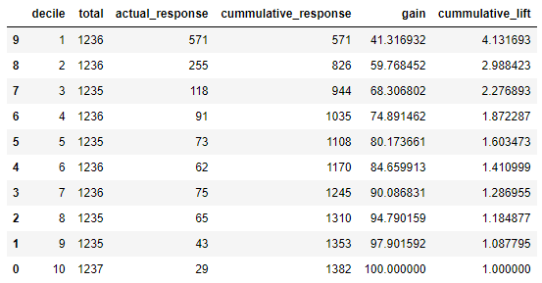
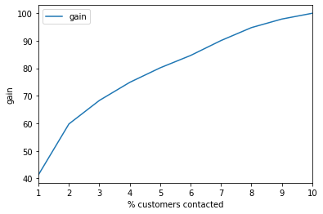
Methodology (continued…)
To achieve our business objective of acquiring 80% of total responders at the minimum possible cost, we need to target only top 50% of the total customers.

Slide 5
Methodology (continued…)
Determining cost of acquisition
Formula given:
cost = 1*number of contacts made in the current campaign
Calculation:
cost = 1* (50% of 12357) = ₹6178.5
Here, 12357 is the total number of customers taken from test dataset used for model testing.

